Slide 1
Scalable Database Phase 2
Niyati Patil

Slide 2
Contents
Creating of Hive and Executing the Queries
Applying Machine Learning Algorithms
Making Predictions
Conclusion

Slide 3
Step1:
Extracting the 1997 year data from the link provided: wget https://dataverse.harvard.edu/api/access/datafile/:persistentId?persistentId=doi:10.7910/DVN/HG7NV7/RUGDRW
Loading and changing the file name in the Hadoop:
Unzip the File
Making the Directory
Creating the Hive

Slide 4
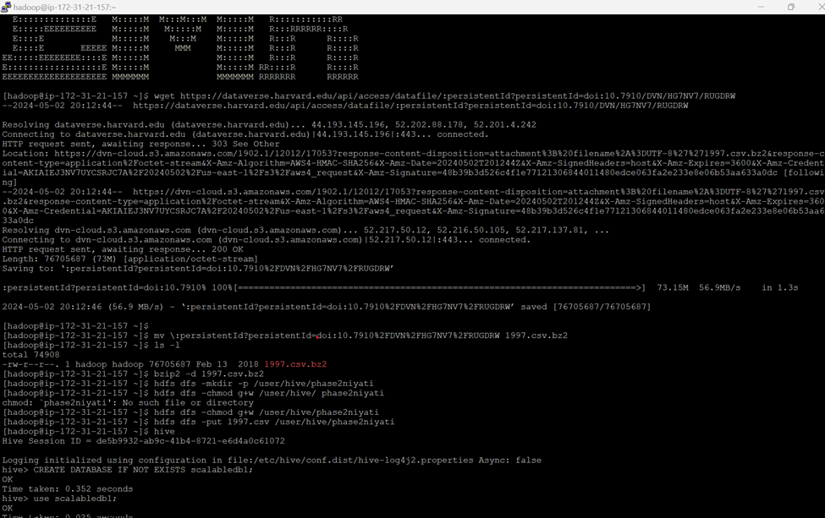

Slide 5
Step2:
Creating Database
Creating Table and Sample Table
Loading the data
Query for making Random Sampling with LIMIT 30000;
INSERT INTO TABLE niyati_sample1
SELECT * FROM niyatii1997
DISTRIBUTE BY RAND()
SORT BY RAND()
LIMIT 30000;

Slide 7
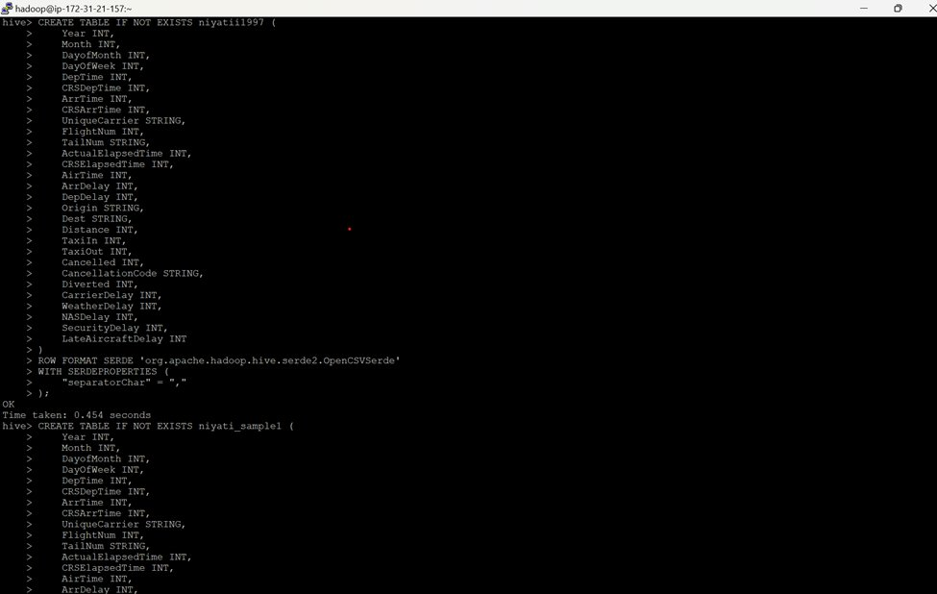

Slide 8
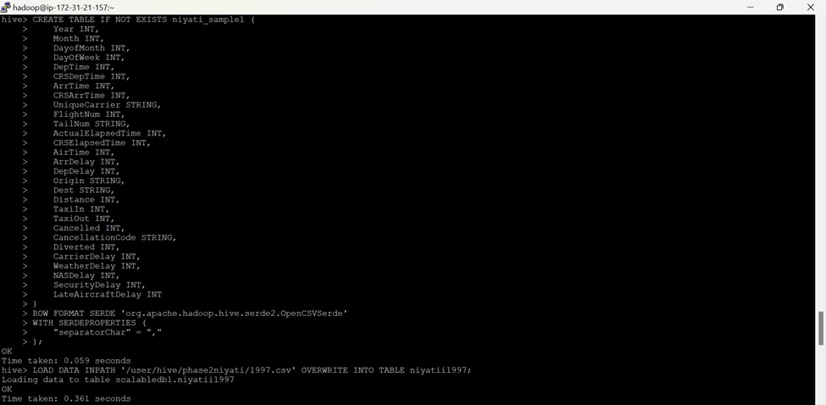

Slide 9
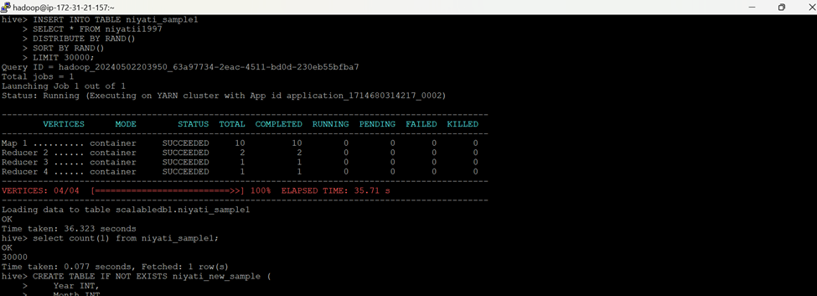

Slide 10
Step3:
Creating new Sample Table with Delayed Column
Query for the Delayed Column
Drop the Sample Table
Alter the Delayed Table to Sample Table

Slide 11
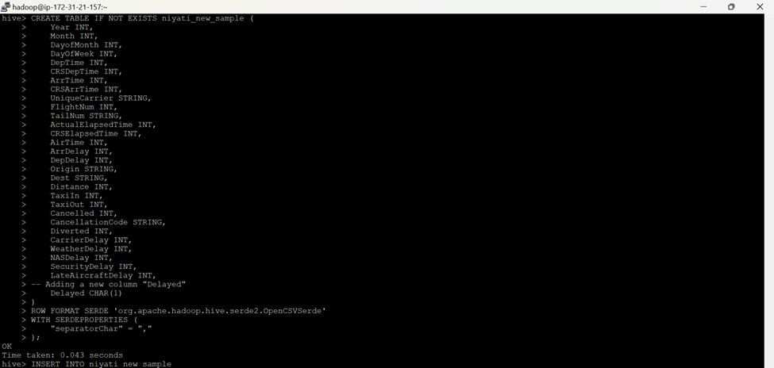

Slide 12
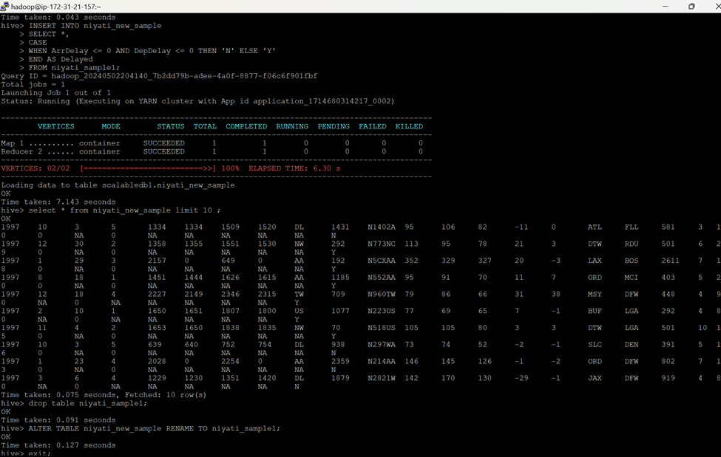

Slide 13
Step4:
Creating a new Directory for Selected Data
Adding the Header
Downloading the file in .csv format

Slide 14
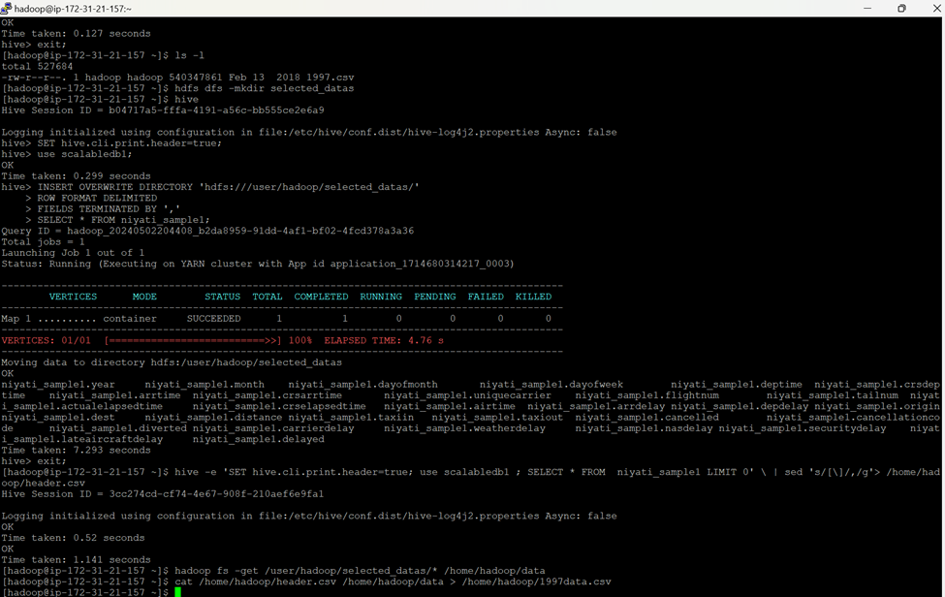

Slide 15
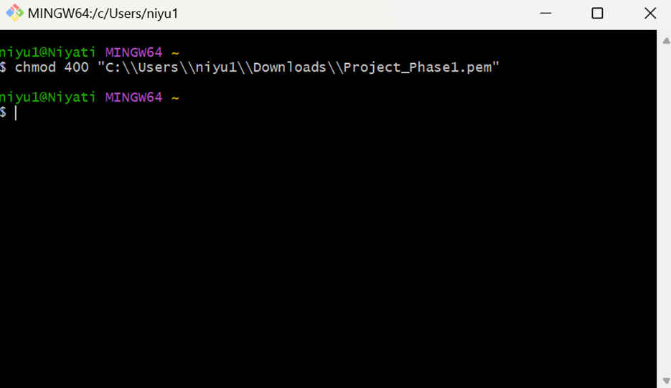
Since I don't know how to download the file using .ppk I used .pem and run the chmod 400 in Git Bash.

Slide 16
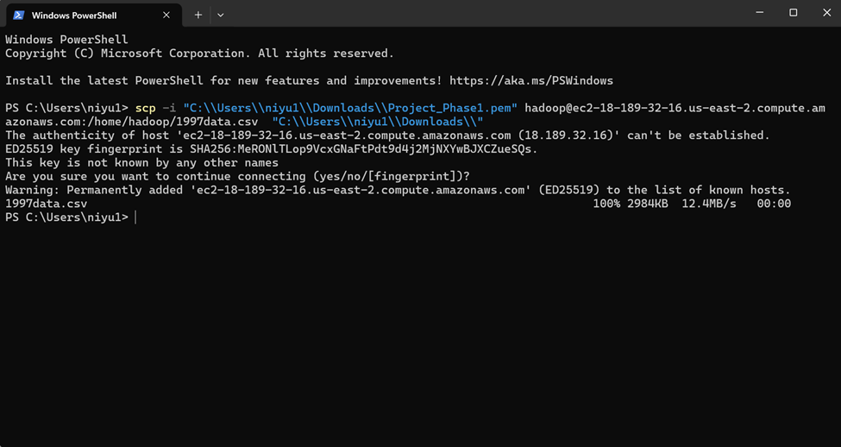
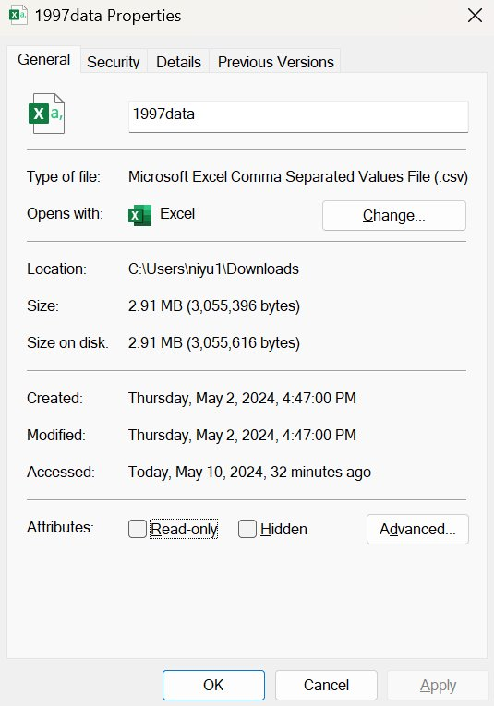
With Windows Power shell, I had downloaded the csv file for further analyzation.

Slide 17
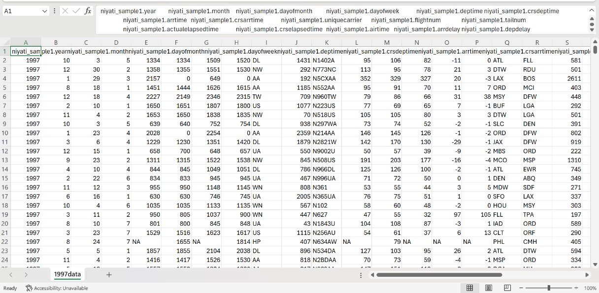

Slide 18
Step5: Apply Machine Learning Models
Importing Libraries
Loading the Combined data of all the Years
Removing the duplicate name in the Header
Performing EDA
Data Wrangling and Cleaning
Applying RandomForestClassifier Model
Splitting and Training the Model
Analyzing the outcome
Saving and Storing the Trained Model
PS: Detailed information in .ipynb file. As I can't include all the screenshots.

Slide 19
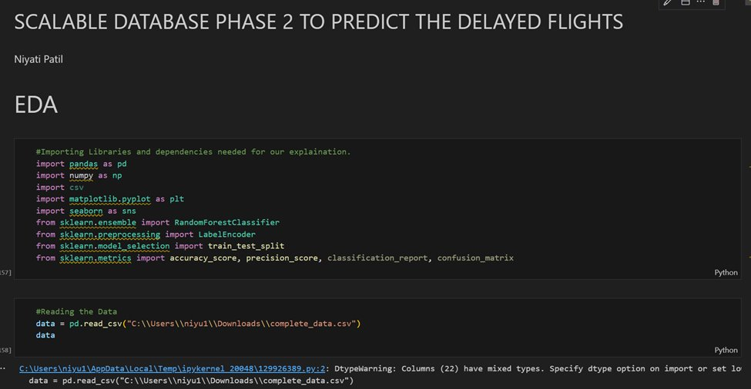

Slide 20
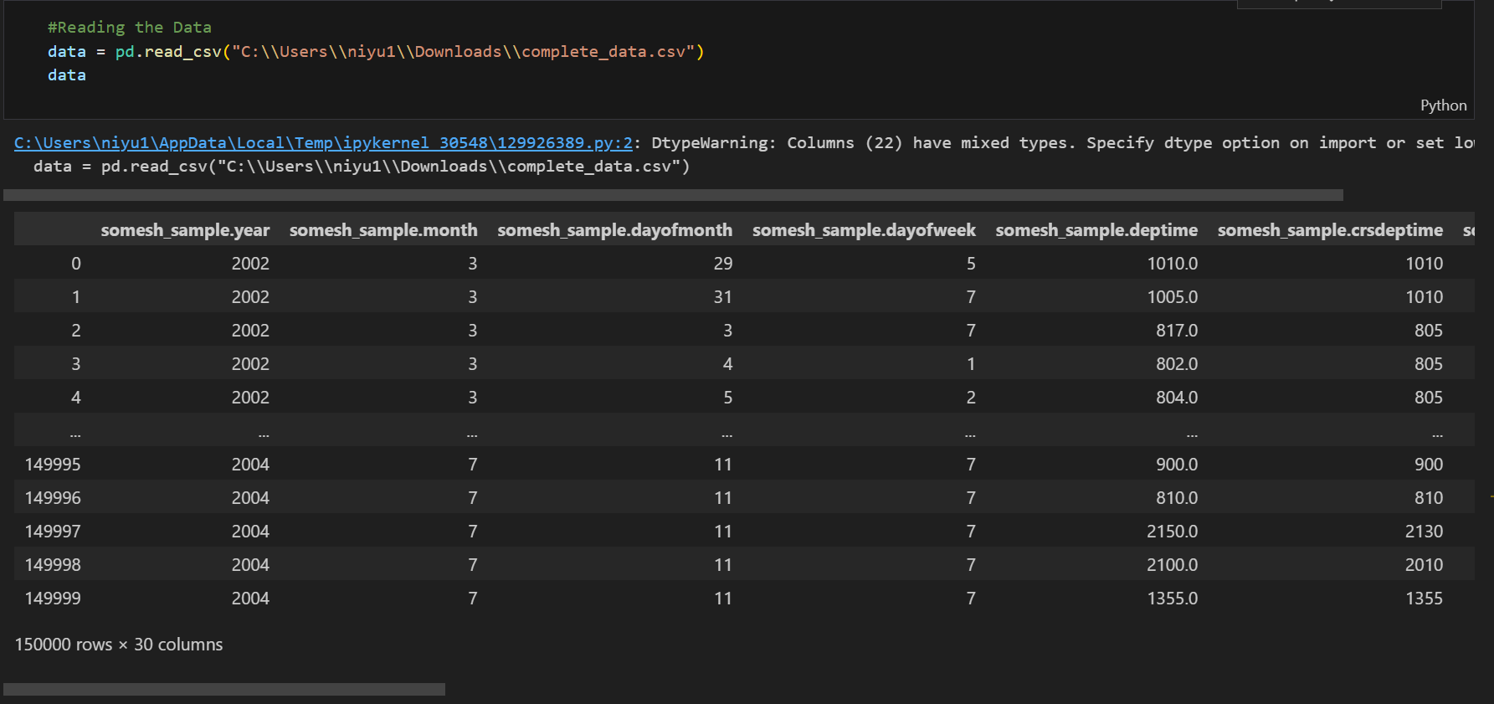
Since Somesh has collaborated all the files and merged it into 1 (complete_data.csv) file, the prefix is shown as Somesh

Slide 21
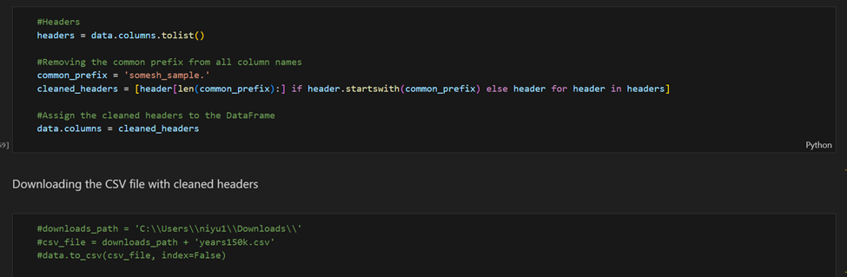
Removing the header prefix to get a readable headers.

Slide 22
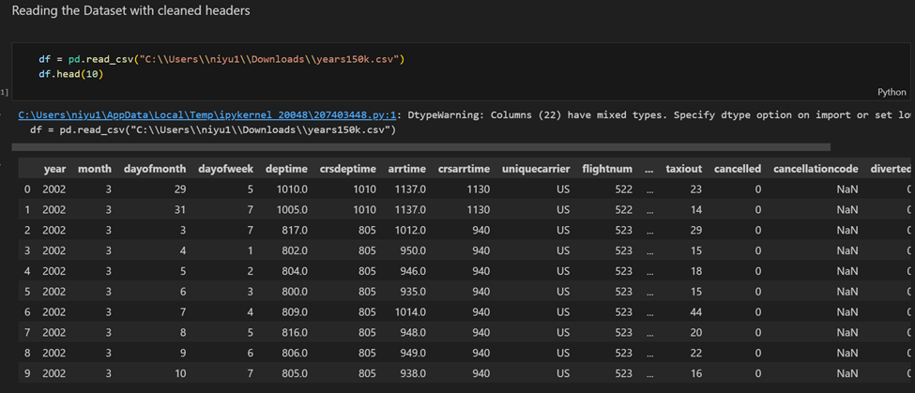

Slide 23
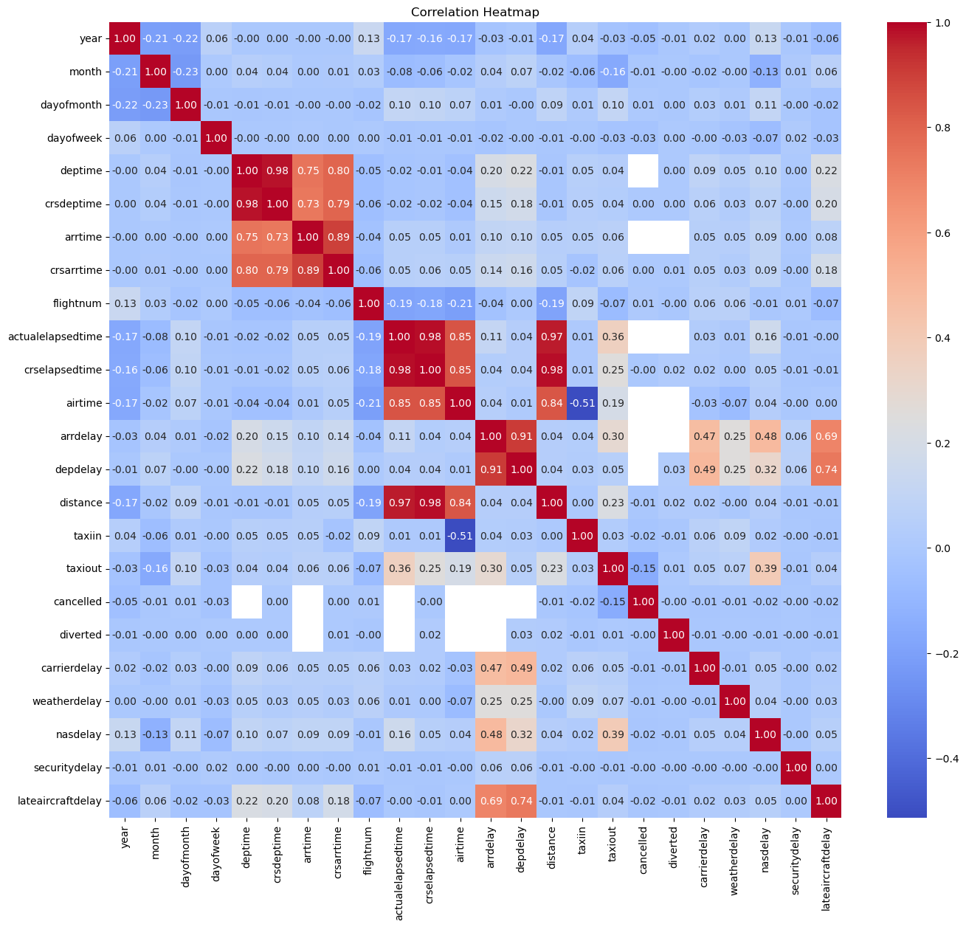
Correlation Heat Map

Slide 24
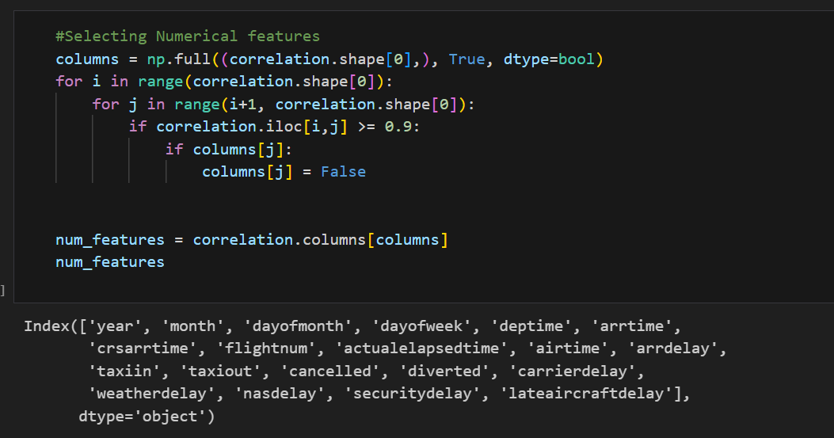
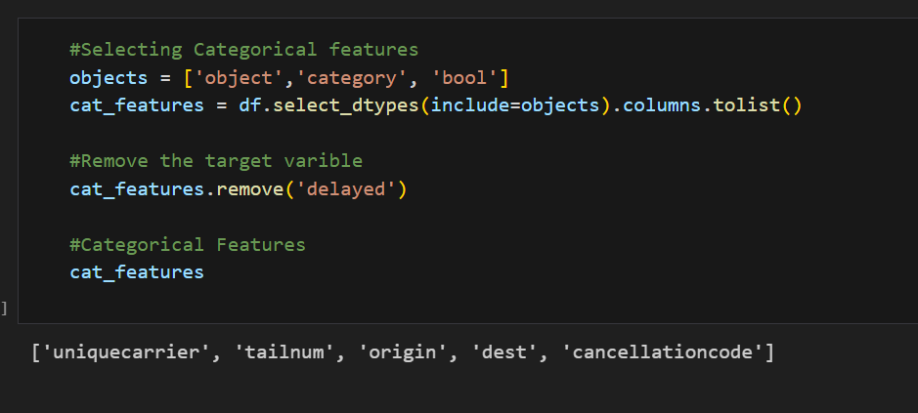
Getting Numerical and Categorical Features

Slide 25
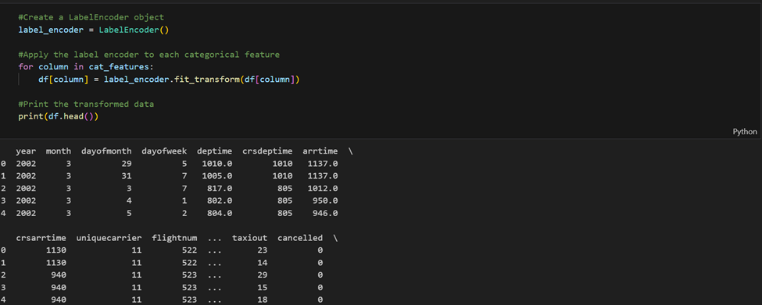
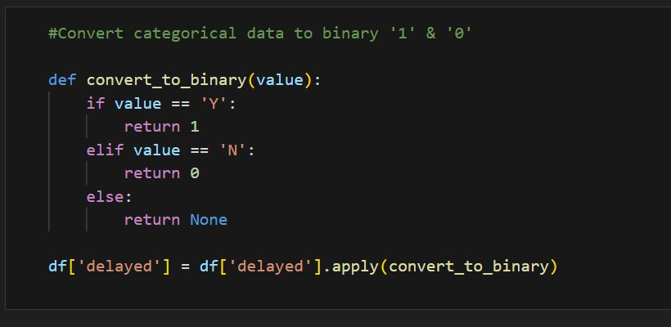

Slide 26
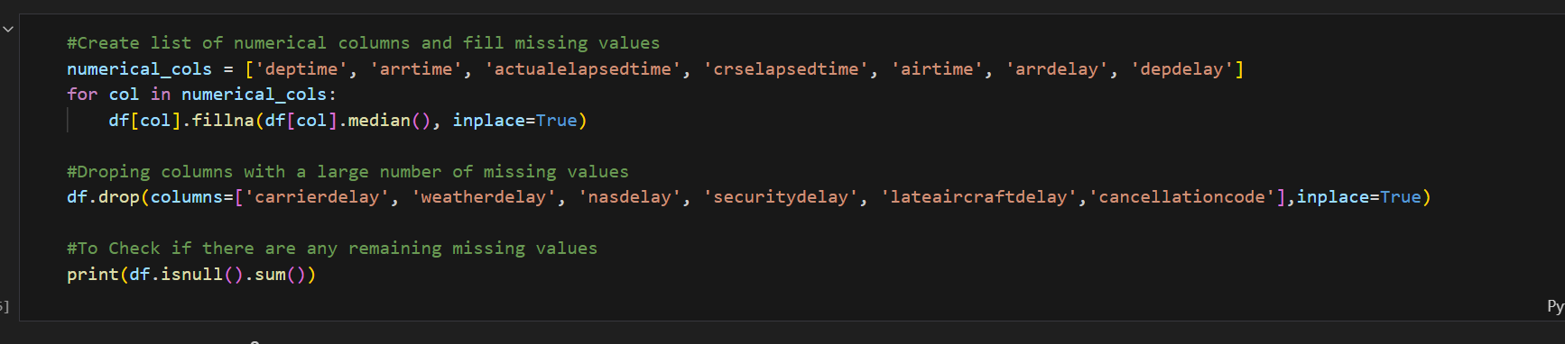

Slide 27
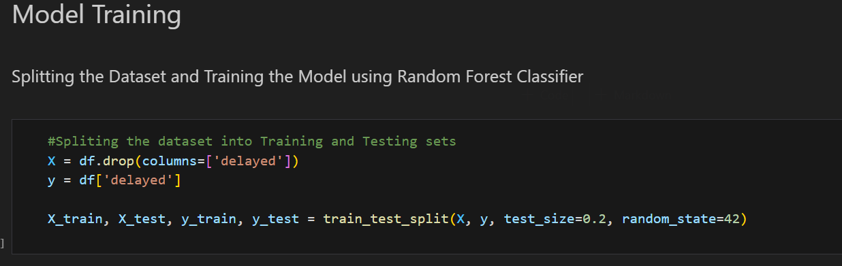
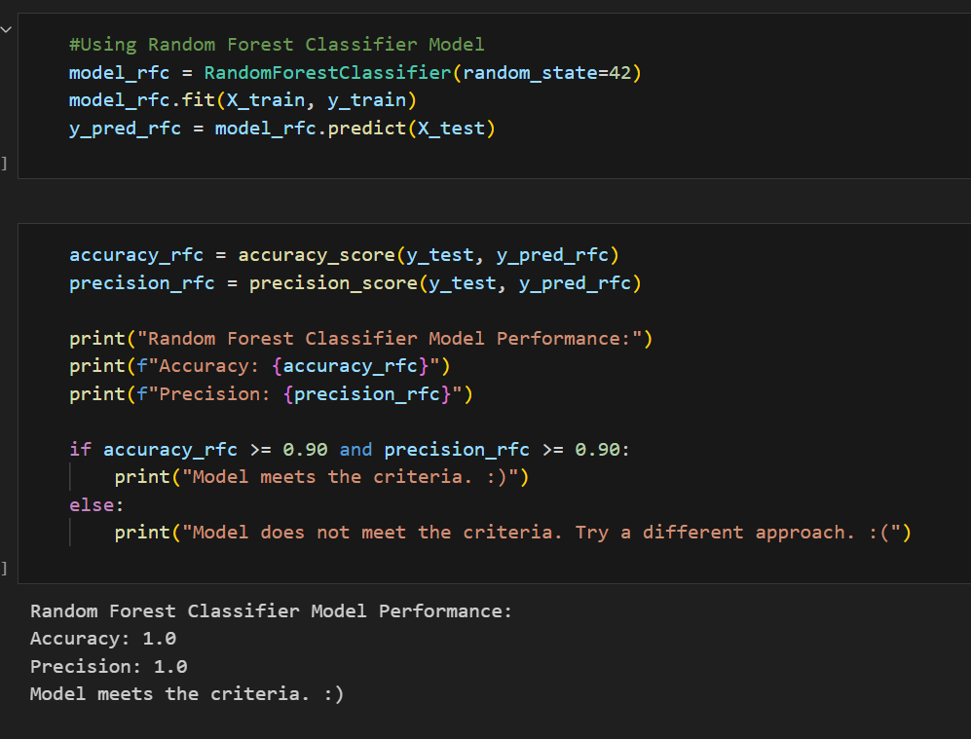

Slide 28
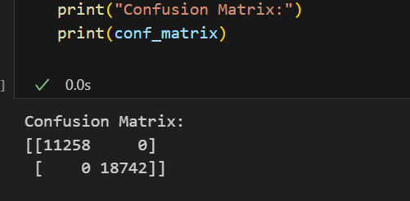
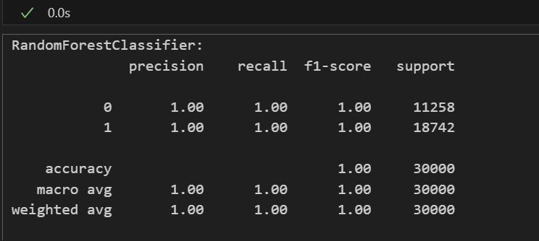
Confusion Matrix and Classification Report

Slide 29
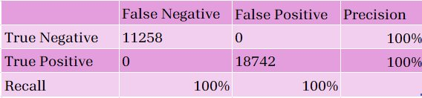
Confusion Matrix and Classification Report
Confusion Matrix: This matrix shows that the model correctly predicted 11258 instances of the first class (true negatives) and 18742 instances of the second class (true positives). There were no false negatives or false positives, which is why the model achieved perfect precision and accuracy.
Accuracy: Is simply a ratio of correctly predicted observation to the total observations. In this case, it’s 1.00, which is perfect.​
Precision: This is the ratio of correctly predicted positive observations to the total predicted positives. ​
Recall: This is the ratio of correctly predicted positive observations to all observations in actual class.

Slide 30
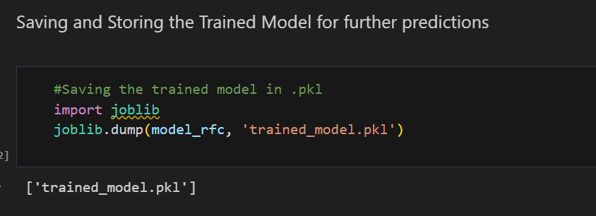
When you save a trained machine learning model using joblib.dump() with a .pkl extension, you're essentially serializing the model object into a file, making it easy to store, share, and load the model later for further training.

Slide 31
Step6:
Loading the 10 record Dataset provided by the Professor
Performing EDA
Pre-Processing the Data
Fitting the Model to the Dataset
Predicting the Delayed flights
Converting it into Yes and No
Saving the file in .csv format

Slide 32
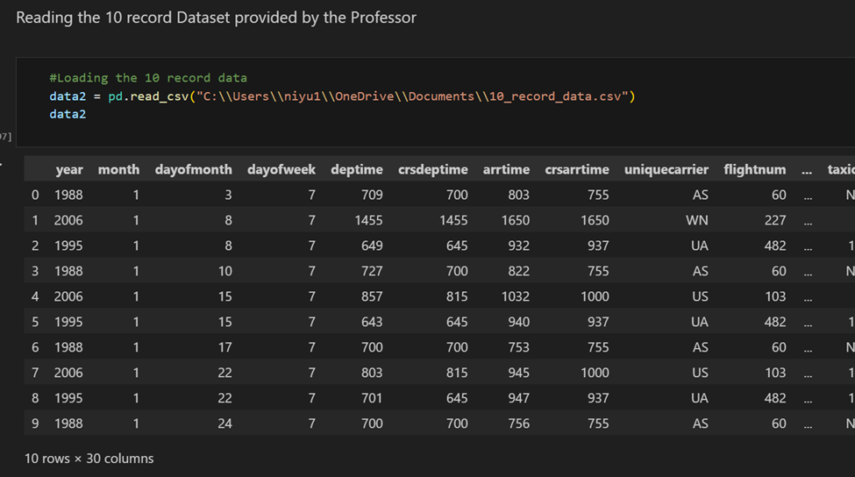

Slide 33
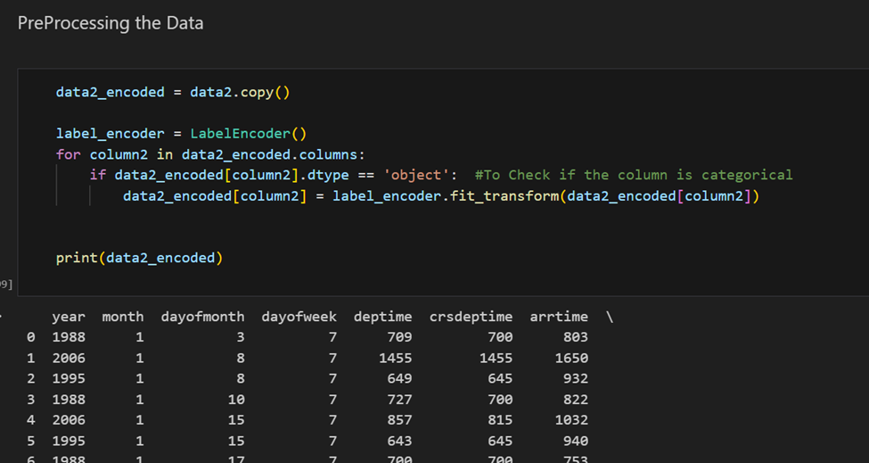

Slide 34
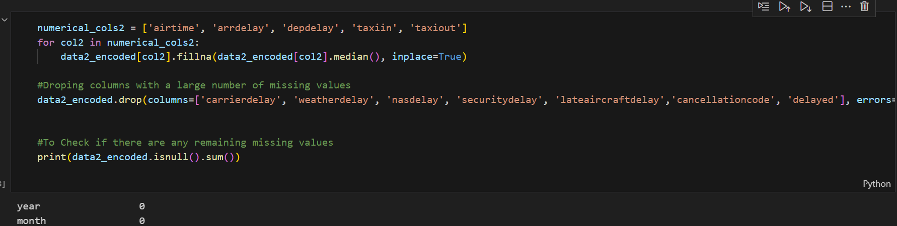

Slide 35
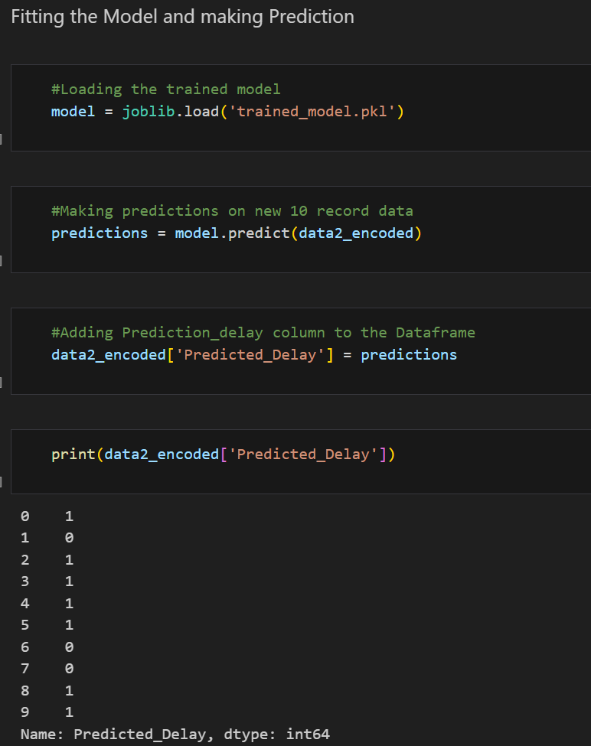
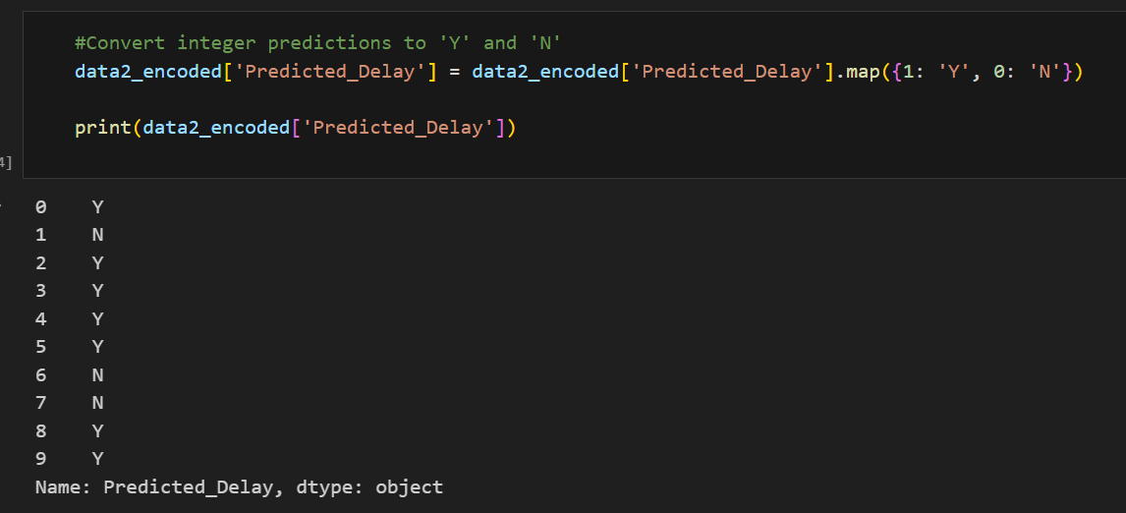

Slide 36
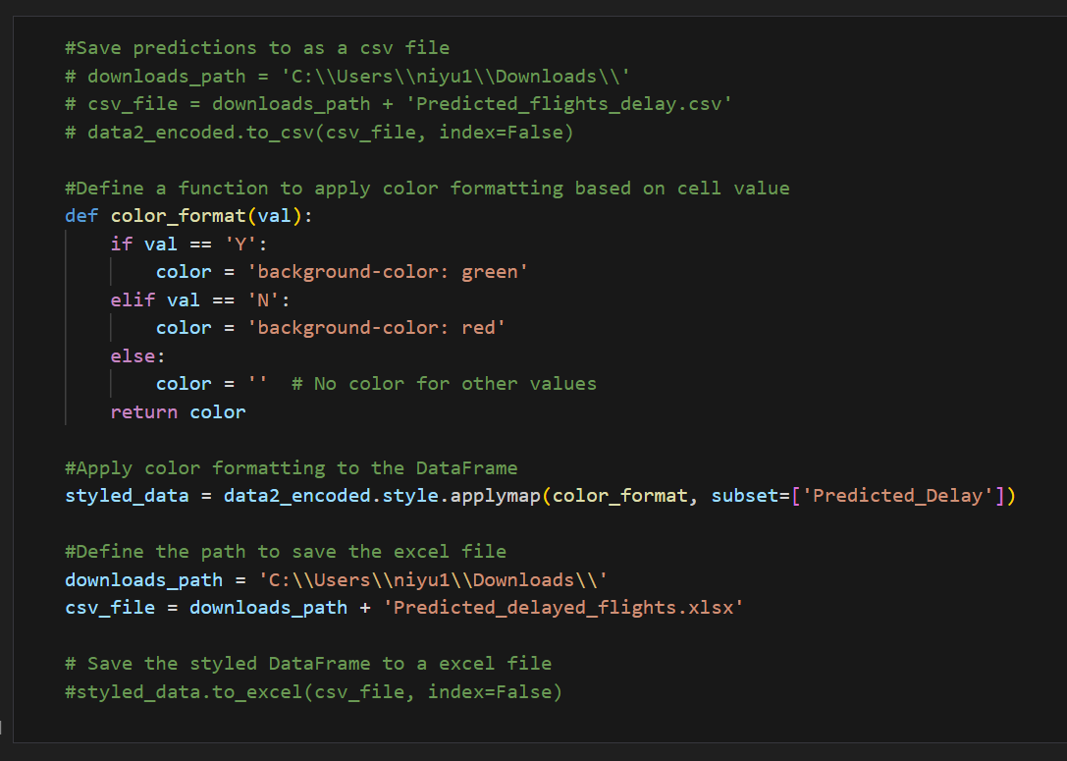
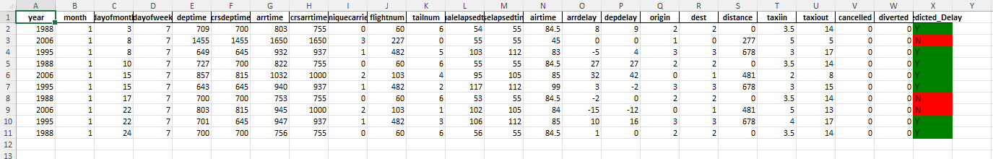

Slide 37
Feel free to reach out if you have any questions.
Thank You!
Links:
GitHub:https://github.com/niyatidpatil
LinkedIn: https://www.linkedin.com/in/niyati-patil/
Colab: https://colab.research.google.com/drive/1pdFlt946rq7F6FGL05h5jbKzBJYeyyZL?usp=sharing

